Slide 1
DIP – Final Project BackLight Image Process
組員：柯劭函、游庭維、林宗翰、謝承佑

Slide 2
目標
人物為主角的背光補償
假設光源在後方
假設人物在圖片中央
避免 histogram equalization 造成的過曝

Slide 3
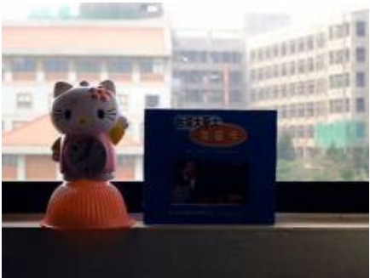
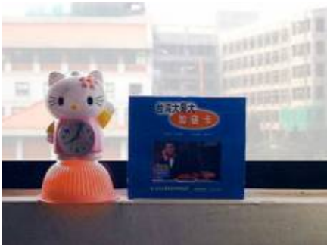
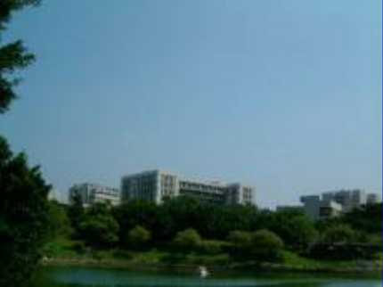
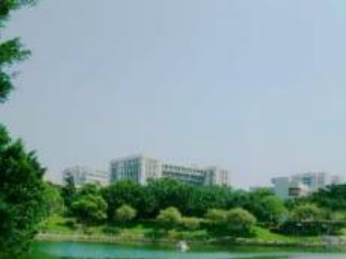
Problem？？

Slide 4
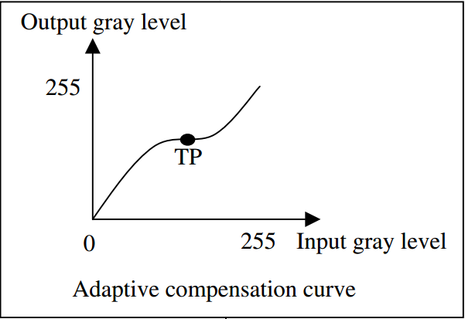
Basic Concept
Input Image
Detect
if backlight or not？
NO
Other Image Problem
Yes
Backlight with high degree
Compensated Image

Slide 5
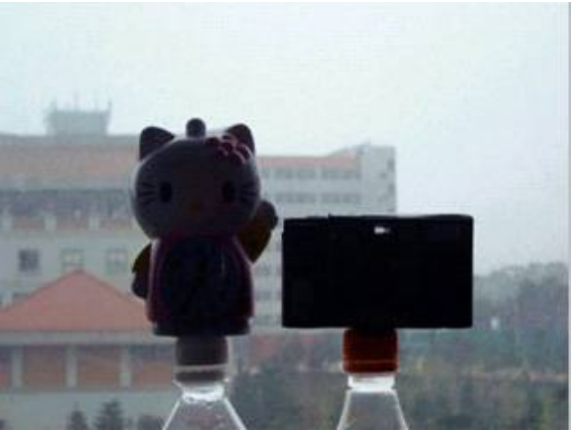
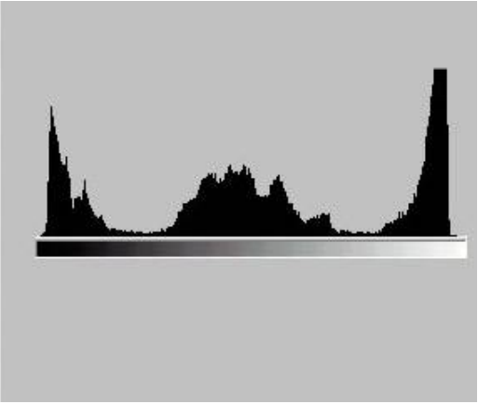
Detection Phase
透過image和histogram兩個方向，利用fuzzy logic得出兩個backlight degree，最後歸納出最後的backlight degree。
Image
Histogram

Slide 6
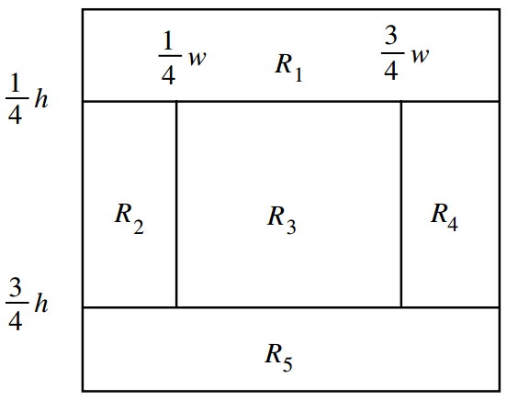
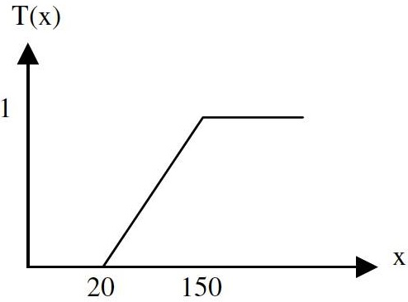
Detection Phase -- Bimage
MRi is the average value of gray level of each area
$$B_{image}=T(\frac{\left[{MR}_{1}+\max\left({MR}_{2},{MR}_{4}\right)\right]}{2}−\frac{\left[{MR}_{3}+{MR}_{5}+\min\left({MR}_{2},{MR}_{4}\right)\right]}{3})$$

Slide 7
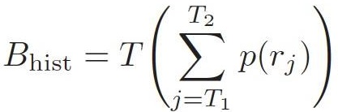
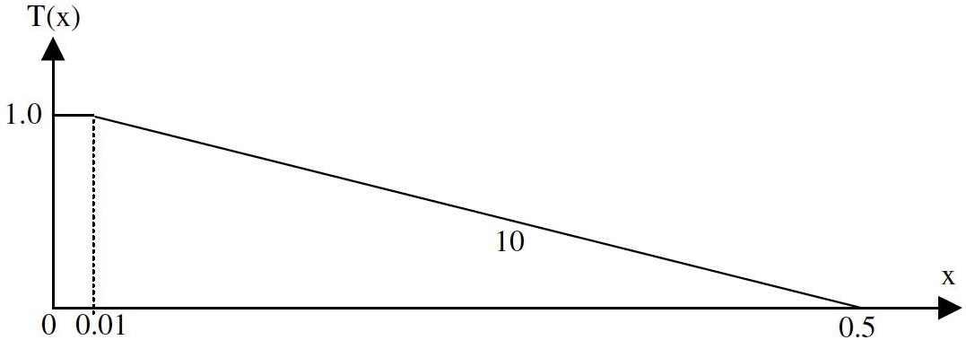
Detection Phase -- Bhist

Slide 8
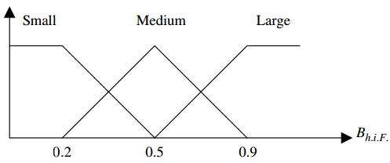
Detection Phase -- Bf
利用fuzzy set統整Bimage和Bhist得到的結果。
利用COA得出最後的Bf。

Slide 9
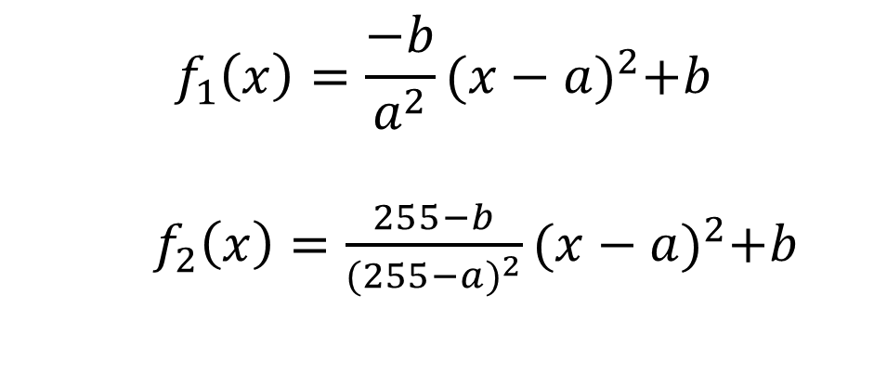
Transformation Function - 1
$$f_{1}\left(x\right)=\frac{−b}{a^{2}}{(x−a)}^{2}+b$$
$f_{2}\left(x\right)=\frac{255−b}{{(255−a)}^{2}}{(x−a)}^{2}+b$

Slide 10
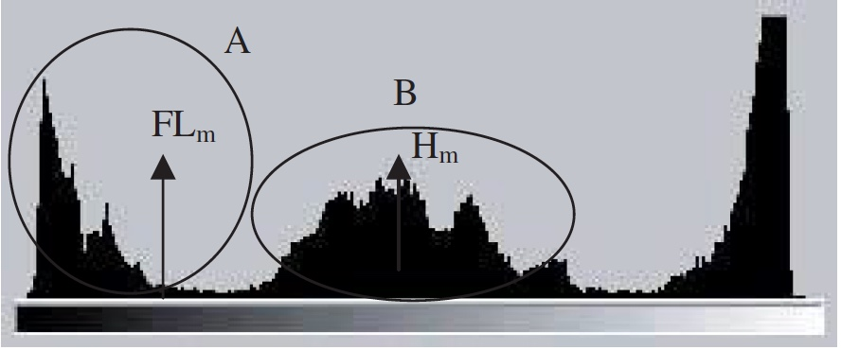

Transformation Function - 2
$$\left(a, b\right)=({FL}_{m}, H_{m})$$

Slide 11
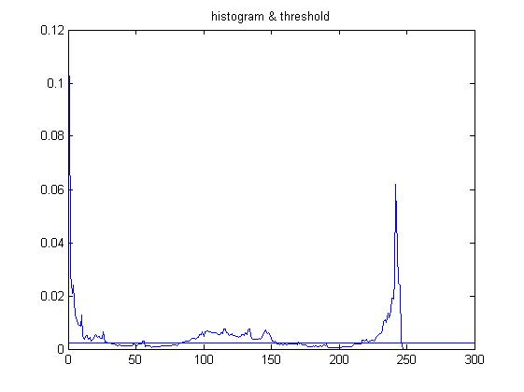
Threshold= 0.0022 Lm = 7.6984 Hm =122.6605 FLm =12.3142
Grouping

Slide 12
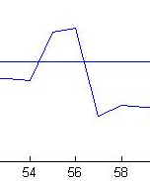
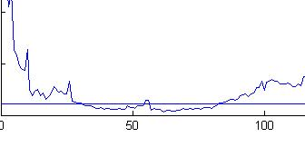
Grouping
規則:
(start, end) 組數不能太多(2~3組)
組不能太小
組之間不能太近

Slide 13

It’s DEMO time！！！

